Slide 1





John B. Anderson Camp #223
Department of
Indiana
Establishment of a Monument/Memorial in Jennings County to Honor Civil War Veterans
Sponsored by the
Sons of Union Veterans of the Civil War
Department of Indiana
John B. Anderson Camp #223
Columbus, Indiana

Slide 2
John B. Anderson Camp #223
Department of
Indiana
Historical Background of Indiana in the Civil War, the GAR, and The SUVCW in
Bartholomew County

Slide 3
John B. Anderson Camp #223
Department of
Indiana
Indiana’s Role in the Civil War
Indiana played an important role during the American Civil War. During the course of the war, Indiana contributed approximately 210,000 soldiers and millions of dollars of horses, food and supplies to the U.S. Army. Hoosiers served in every major engagement of the war and almost every engagement – minor or otherwise – in the western theater of the war. As an agriculturally rich state containing the fifth-highest population in the Union and sixth-highest of all states, Indiana was critical to Northern success.
The Sons of Union Veterans of the Civil War seek to preserve the history and legacy of those heroes who fought and worked to save the Union.

Slide 4
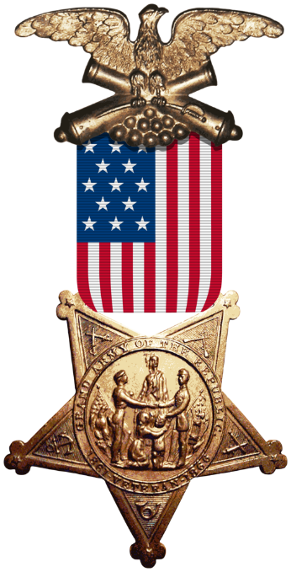
The Grand Army of the Republic
John B. Anderson Camp #223
Department of
Indiana

Slide 5
The Grand Army of the Republic
John B. Anderson Camp #223
Department of
Indiana
Fraternal organizations have always been popular in America, so it is no surprise that the soldier and sailors who survived the Civil War would want to share their experiences and rekindle friendships forged in battle.
The organization known as the Grand Army of the Republic was formed in Decatur, Illinois by Benjamin F. Stevenson in 1866. The organization was based upon the principles of “Fraternity, Charity, and Loyalty.”

Slide 6
John B. Anderson Camp #223
Department of
Indiana
Known as the GAR it became one of the first organizations to support voting rights for black veterans, and lobbying Congress to establish pensions for veterans. The organization consisted of “Departments” at the State level and “Posts” at the community level. The GAR has had a total of 598 Posts in Indiana over the years of its existence.
Eventually the membership topped 490,000 and it became a political force to recon with. In fact, it was impossible to win the presidency without the support of the GAR.

Slide 7
John B. Anderson Camp #223
Department of
Indiana

Slide 8

John B. Anderson Camp #223
Department of
Indiana
Sons of Union Veterans of the Civil War

Slide 9
John B. Anderson Camp #223
Department of
Indiana
Sons of Union Veterans of the Civil War
In 1881 the GAR formed the Sons of Veterans of the United States of America (SV) to carry on its traditions and memory long after the GAR had ceased to exist. Membership was open to any man who could prove ancestry to a member of the GAR or to a veteran eligible for membership in the GAR.
Many GAR Posts sponsored Camps of the SV. In 1925 the SV name was changed to Sons of Union Veterans of the Civil War (SUVCW), under which its federal charter was issued in 1954. The SUVCW is legally recognized as the heir to, and representative of, the GAR.

Slide 10
John B. Anderson Camp #223
Department of
Indiana
Sons of Union Veterans of the Civil War
Today, the National Organization of the SUVCW, headed by an annually elected Commander-in-Chief, oversees the operation of 26 Departments, each consisting of one or more states, a Department-at-Large, a National Membership-at-Large, and over 200 community based camps. More than 6,360 men enjoy the benefits of membership in the only male organization dedicated to the principles of the GAR — Fraternity, Charity, and Loyalty. The SUVCW National Headquarters is located in the National Civil War Museum in Harrisburg, Pennsylvania.
The SUVCW is one of five Allied Orders of the GAR. Ladies of the Grand Army of the Republic, Woman’s Relief Corps, Auxiliary to the Sons of Union Veterans of the Civil War and Daughters of Union Veterans of the Civil War.

Slide 11
John B. Anderson Camp #223
Department of
Indiana
Sons of Union Veterans of the Civil War
Today, the National Organization of the Sons of Union Veterans of the Civil War (SUVCW) is a nation-wide organization, comprised of more than 200 community-based Camps which are organized under 26 Departments. More than 6,360 men enjoy the benefits of membership in the only male organization dedicated to the principles of the GAR — Fraternity, Charity, and Loyalty. The SUVCW National Headquarters is located in the National Civil War Museum in Harrisburg, Pennsylvania.
The Department of Indiana oversees camps and SUVCW members within Indiana.

Slide 12
John B. Anderson Camp #223
Department of
Indiana

Slide 13
John B. Anderson Camp #223
Department of
Indiana

Slide 14
John B. Anderson Camp #223
Department of
Indiana
Project Proposal:
- The Sons of Union Veterans of the Civil War John B. Anderson Camp #223 will propose the placement/installation of a Civil War stone monument to honor the Civil War Veterans on the Courthouse lawn in Bartholomew County.

Slide 15
John B. Anderson Camp #223
Department of
Indiana

Slide 16
John B. Anderson Camp #223
Department of
Indiana
Indiana Regiments from Jennings County:
Need Information

Slide 17
John B. Anderson Camp #223
Department of
Indiana
Project Proposal Fund Raising Efforts and Monument Description:
- Fund raising efforts will be established and conducted until efficient funds are collected. We have chosen a monument that consists of a Civil War soldier in a great coat standing at In-Place/Parade Rest carved in stone, and this is a common monument at various locations throughout Indiana, as well as across the various “Union” states.

Slide 18
John B. Anderson Camp #223
Department of
Indiana
Overall Cost Estimate:
- The estimate we have received from Shaw Monument (a local stone cutter in Jennings County) for the statue, sub base, and base at a total cost of approximately $29,850.

Slide 19
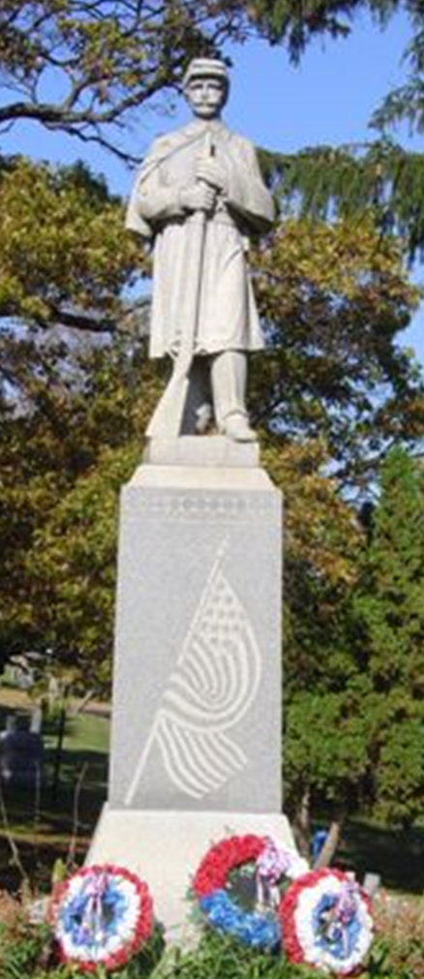
John B. Anderson Camp #223
Department of
Indiana

Slide 20
John B. Anderson Camp #223
Department of
Indiana

Slide 21
John B. Anderson Camp #223
Department of
Indiana
Sample of County Civil War Regiment Numbers that will be placed on the sides of the Monument
Need Information

Slide 22
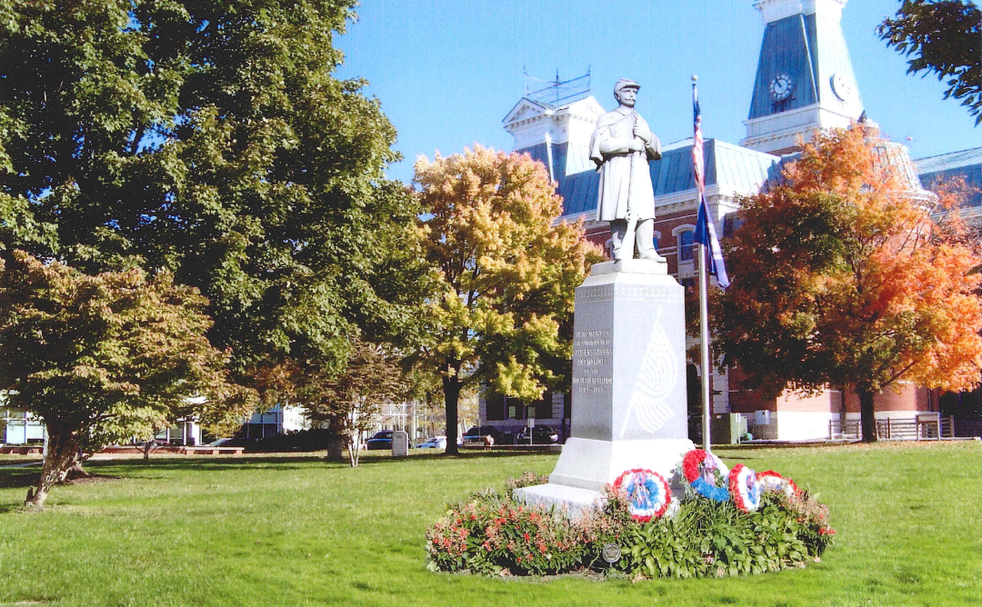
John B. Anderson Camp #223
Department of
Indiana

Slide 23

John B. Anderson Camp #223
Department of
Indiana
“Lest we Forget”
John B. Anderson Camp #223 – Columbus, Indiana
Thank You

